Slide 1
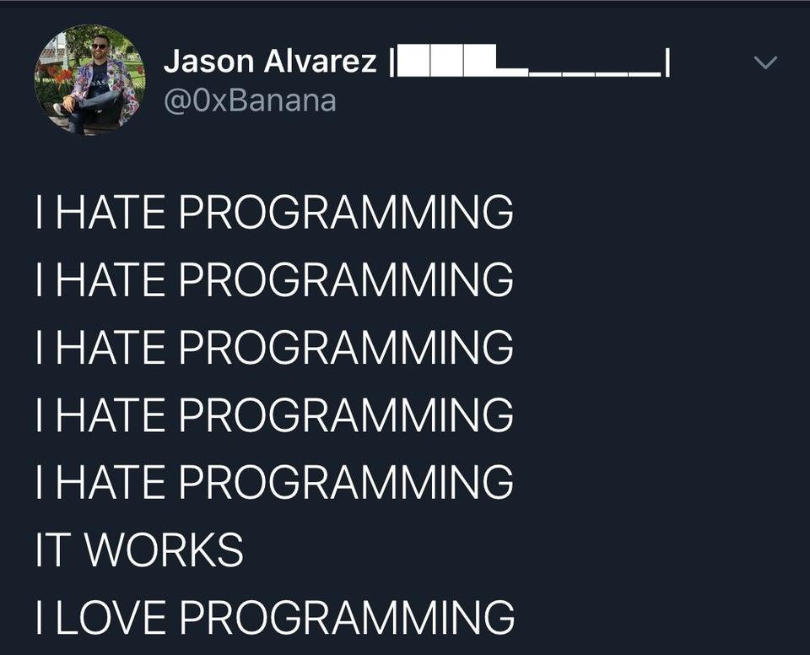

Slide 2
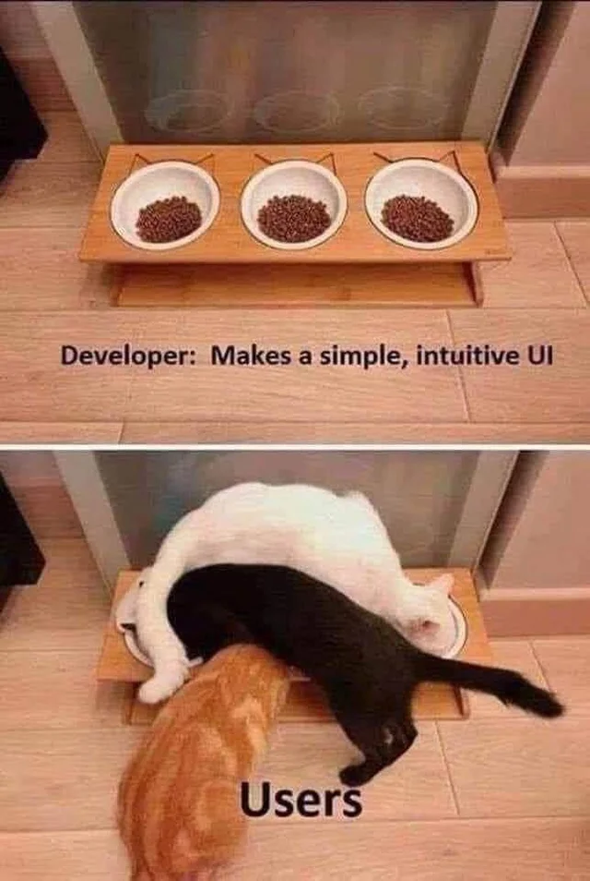

Slide 3
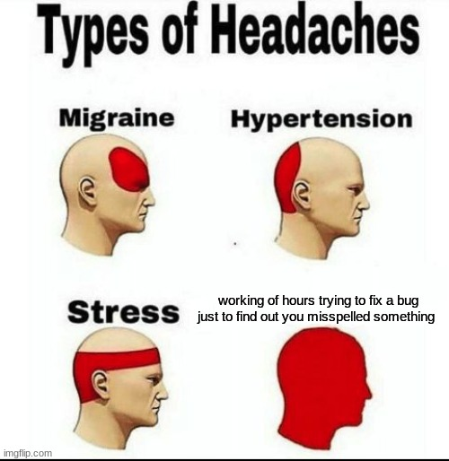

Slide 4


Adam Thomas
Professor, Media Studies and IT Faculty of Media and Creative Arts adam.thomas@humber.ca codeadam.ca
Gary Bhanot
gaurav.bhanot@humber.ca pixelr.io

Slide 5
1. Course Outline

Slide 6
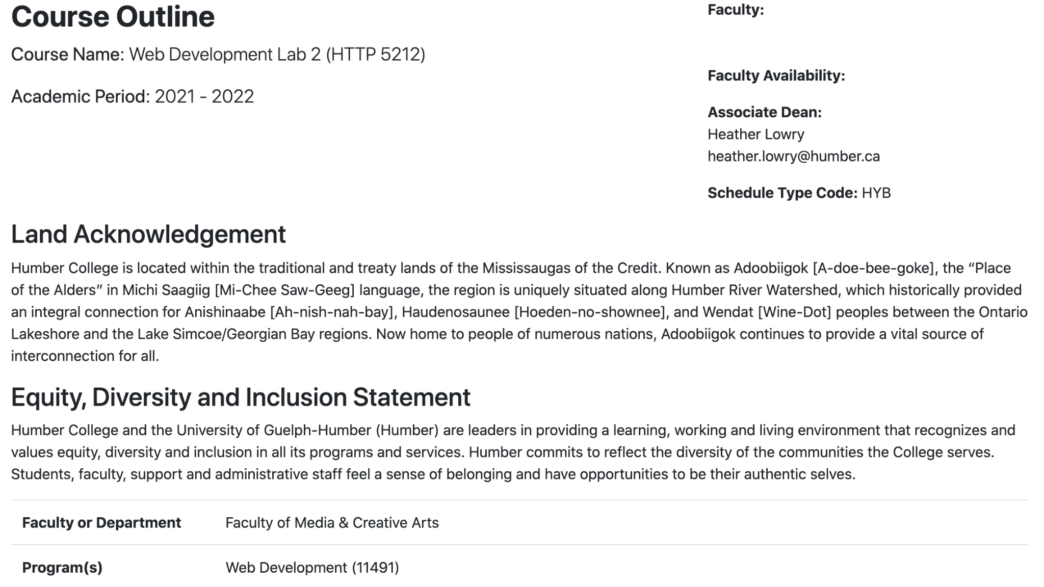

Slide 7
2. Critical Path

Slide 8



Critical Path
Introduction to PHP - 4 Weeks Review of basic PHP syntax.
Advanced PHP - 3 Weeks Integrating PHP with a MySQL database using SQL. Creation of a custom CMS.
Laravel - 7 Weeks Using Laravel to create a CMS. Export content to JSON.

Slide 9
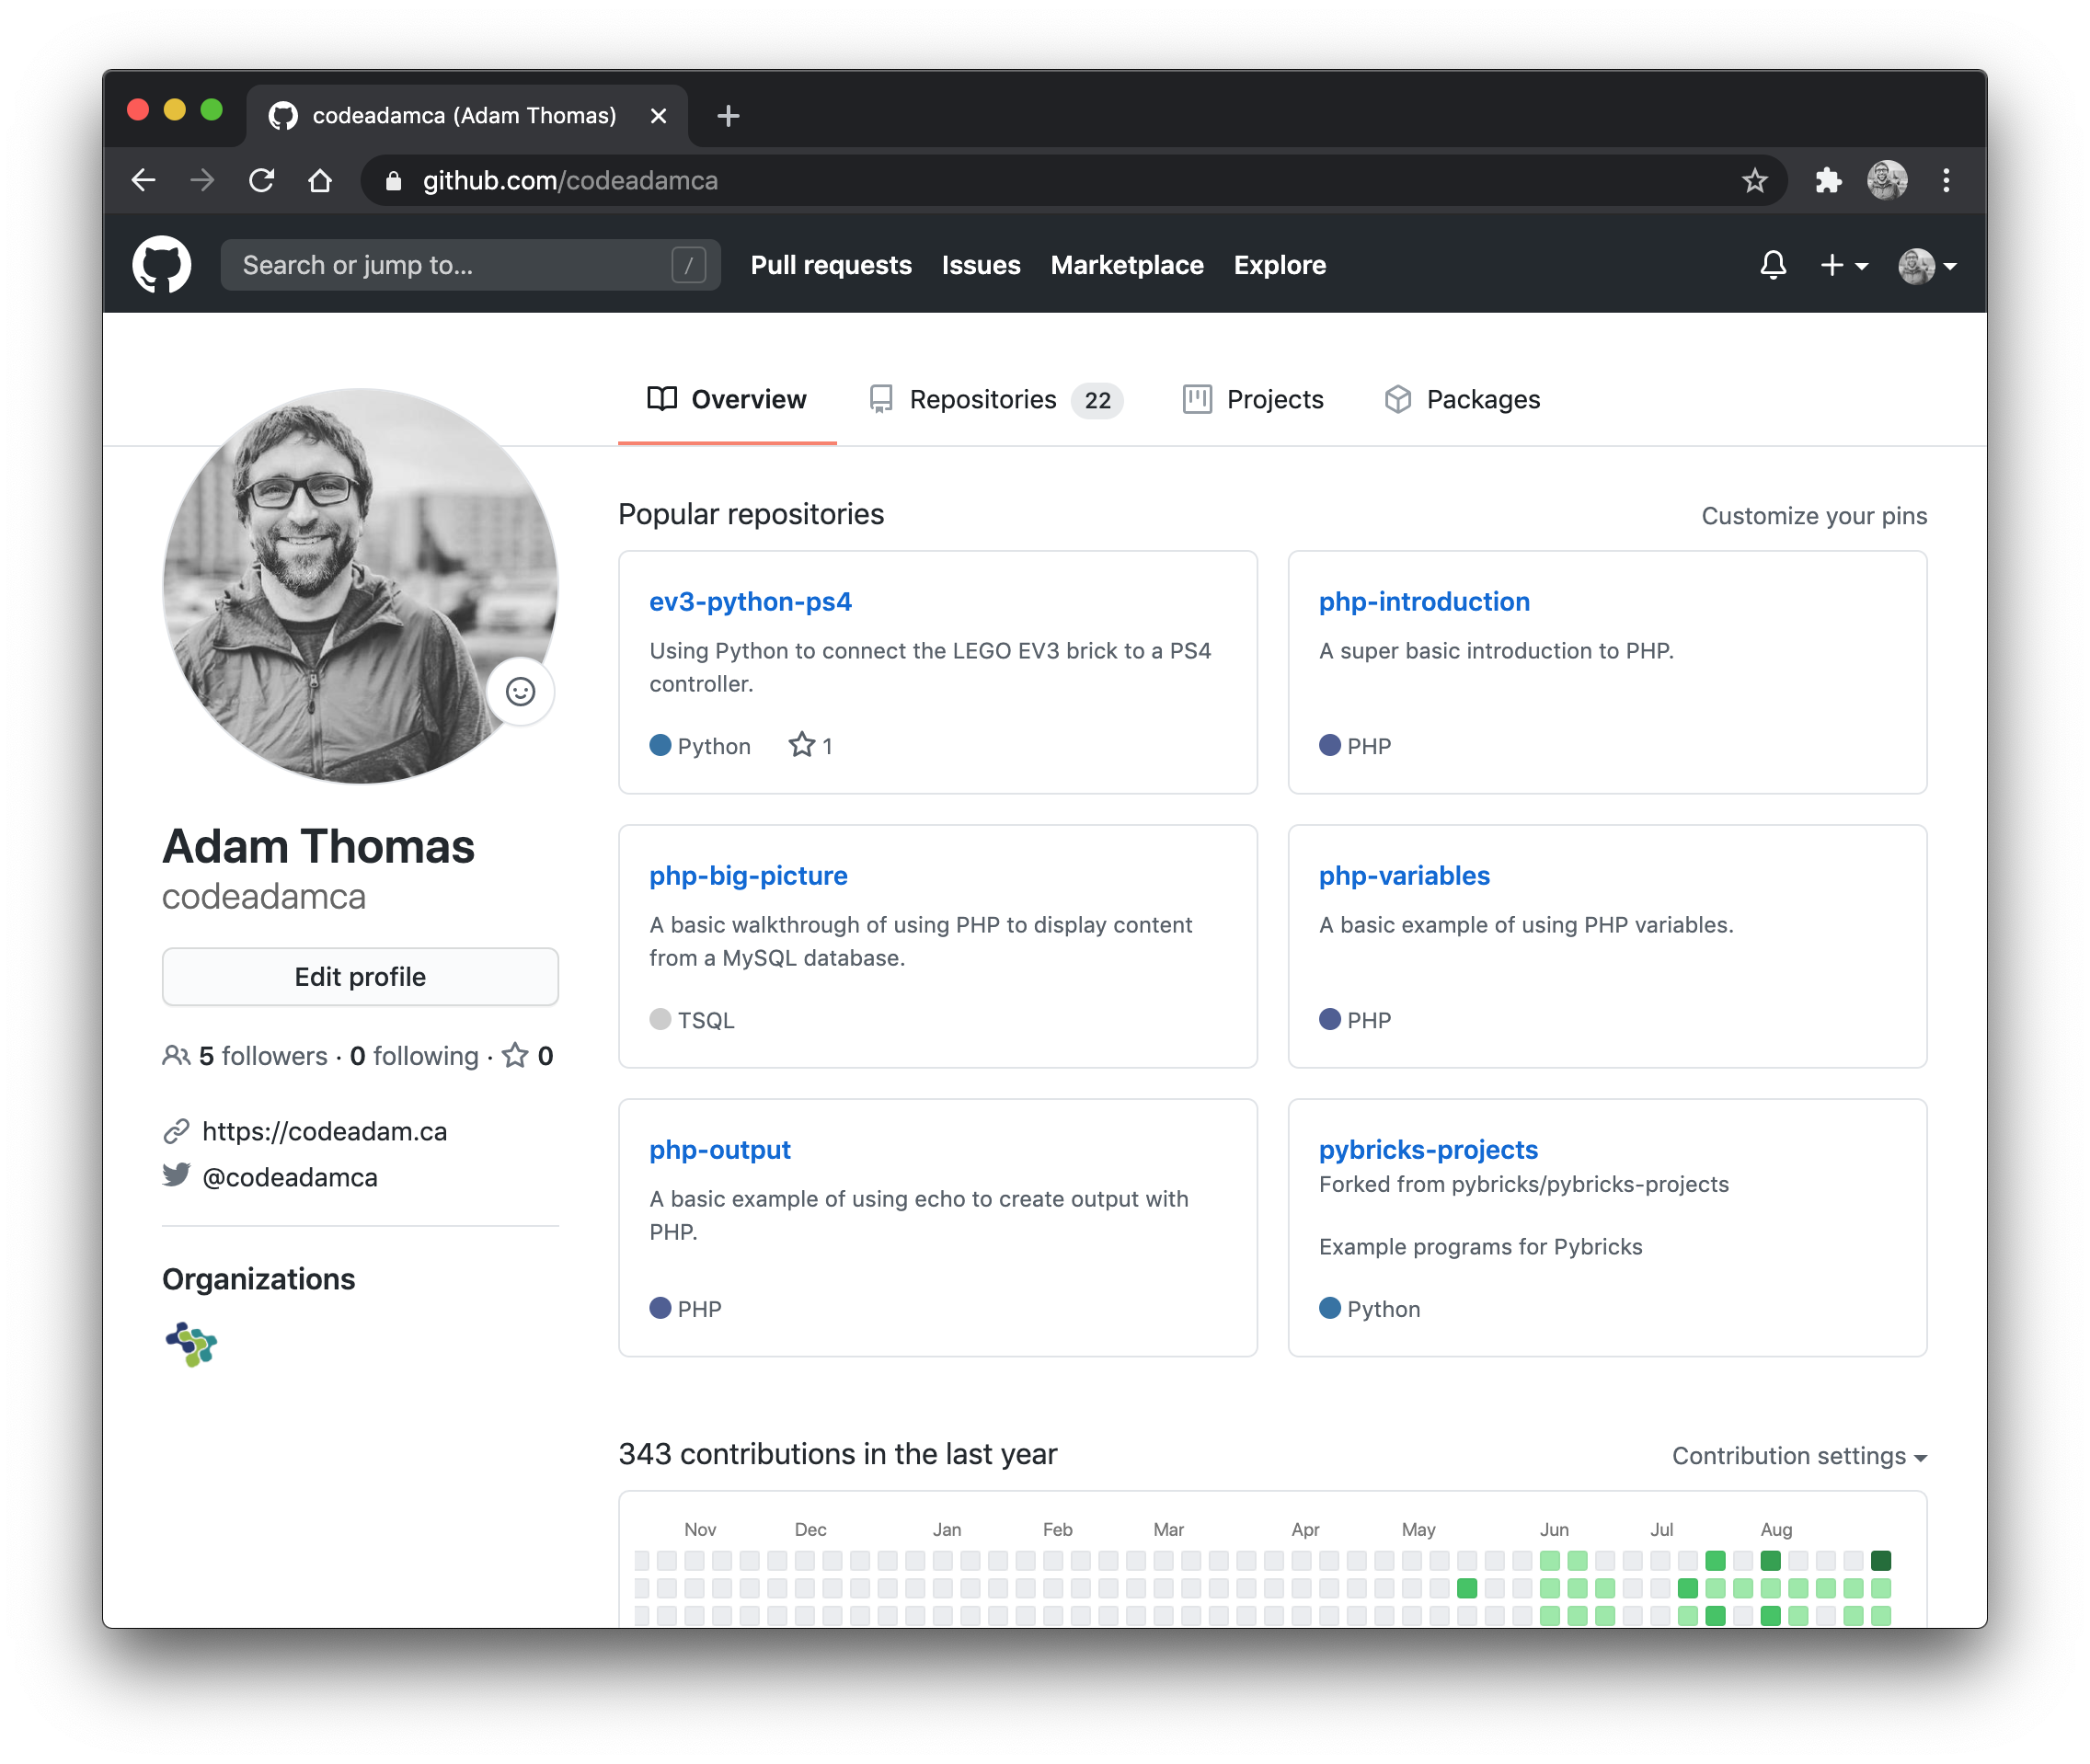
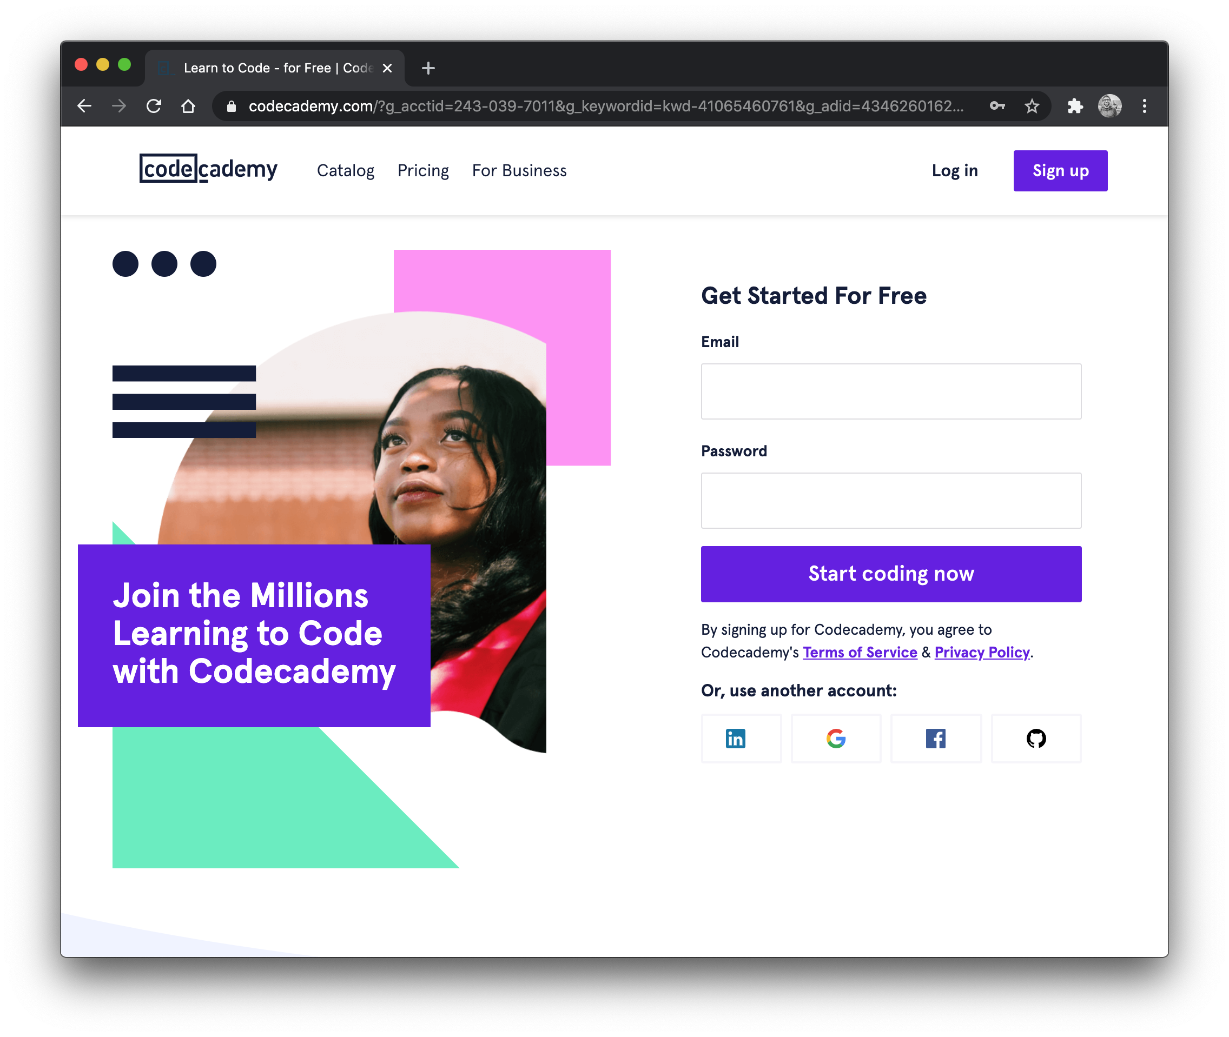
Weekly Class Structure
Lecture + Workshop Every week we will have an in-person lecture at the beginning of the class followed by a workshop where we will go through short coding exercises and a series of short videos to watch or follow along with.

Slide 10
3. Assignments

Slide 11






Assignments
Exercises - 5% A series of exercises complimenting weekly topics.
Assignment #1 - PHP and MySQL - 10%
Assignment #2 - PHP CMS - 15% Create a simple website using a PHP CMS.
Assignment #3 - PHP/Laravel CMS - 20% Create a PHP CMS using PHP and Laravel.

Slide 12
4. Introduction to PHP

Slide 13
















Slide 14
You don’t need to learn all these technologies.
You should understand their
characteristics and roles.

Slide 15
What is PHP?
PHP (recursive acronym for PHP: Hypertext Preprocessor) is a widely-used open source general-purpose scripting language that is especially suited for web development and can be embedded into HTML.
What is PHP? (n.d.). PHP, Retrieved March 5, 2017, from http://php.net/manual/en/intro-whatis.php

Slide 16
Why learn PHP?
Popularity and community support Ease of learning Cross Platform Compatibility Extensive Library Support Cost Effective Job Opportunities and Freelance

Slide 17
PHP Marketshare
According to W3Techs, PHP is used by around 79% of all websites. It’s eight times more popular than ASP.NET, its nearest rival in server-side programming languages.

Slide 18
Downsides
Scalability and Performance Complexity in Large Projects Security

Slide 19
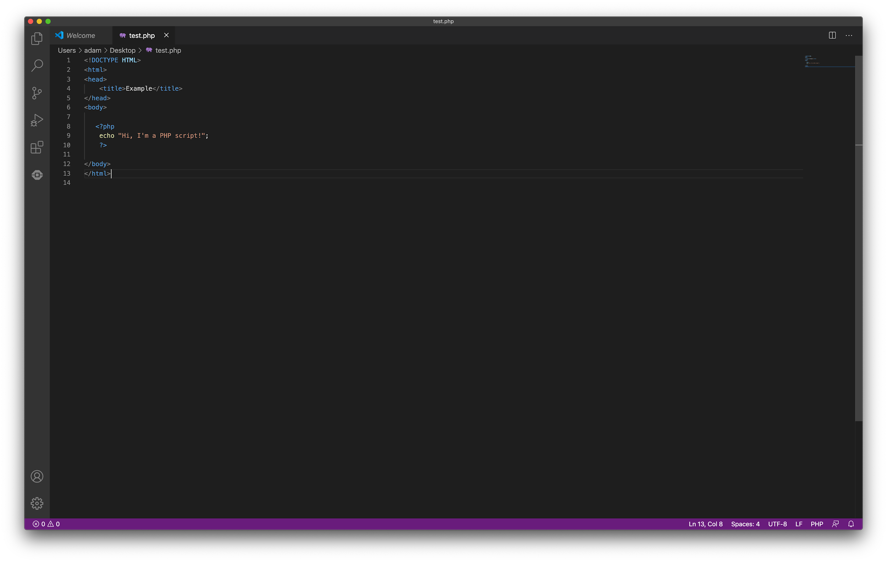
Where does PHP go?
PHP is embedded directly into your HTML.
PHP cannot be tested like HTML, CSS, and JavaScript.
PHP code must be uploaded to your server and tested using your domain name.

Slide 20
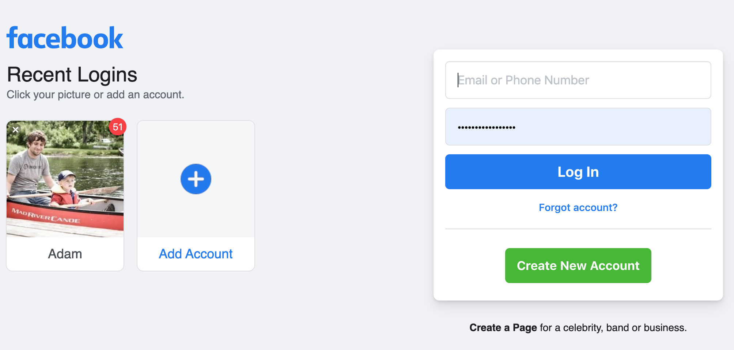
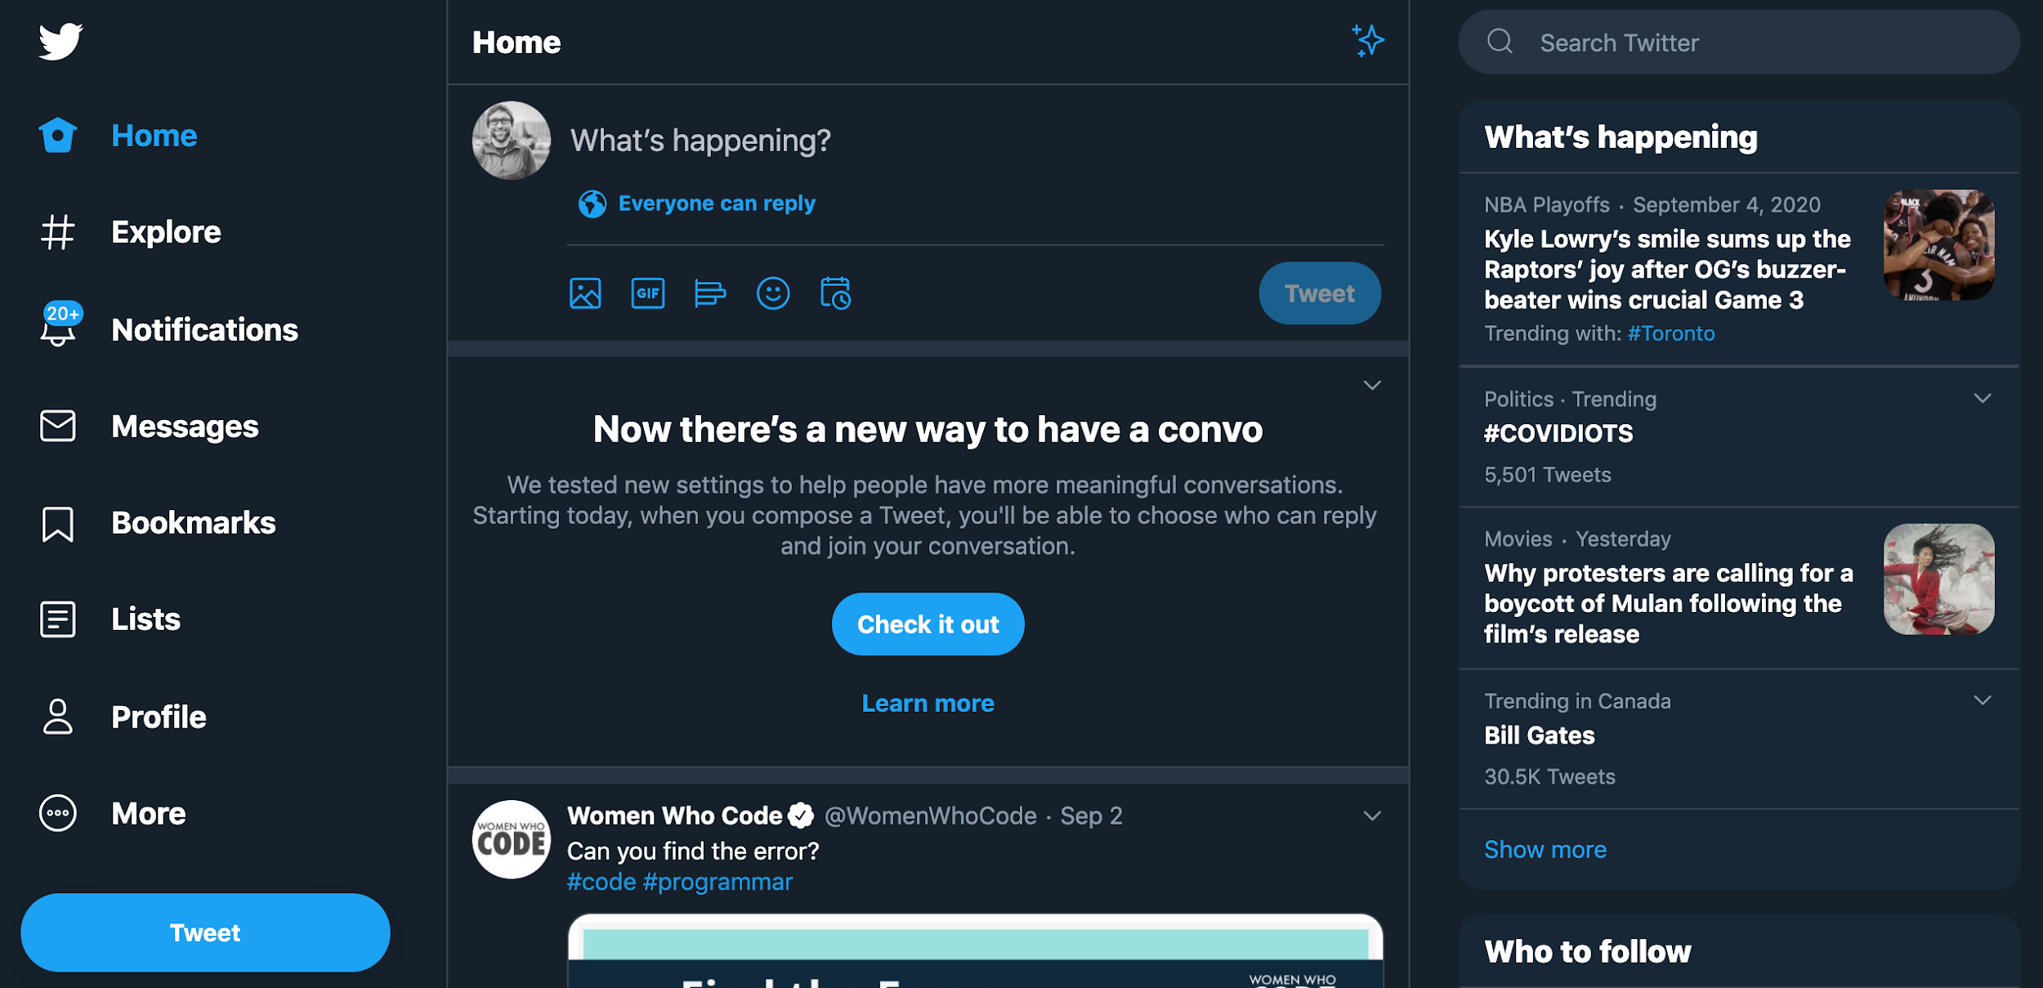
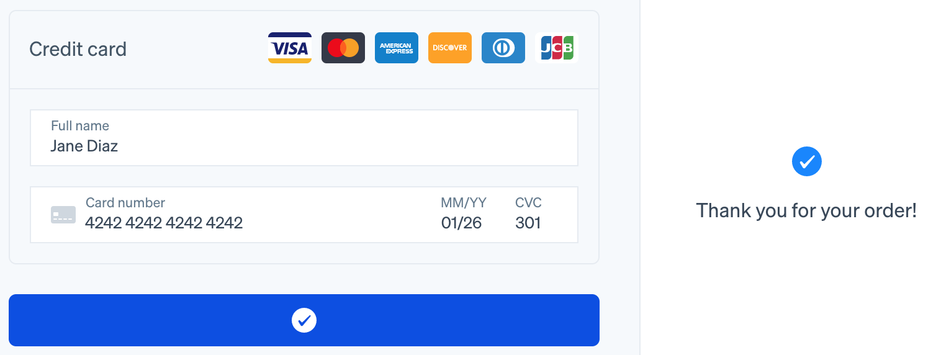
What does PHP do?
Where does the information in a contact form go?
What happens then you submit a username and password?
What happens when you create a new tweet?
What happens when you submit credit card information?

Slide 21





95,000,000 new photos daily
1,000,000 videos viewed daily
2,800,000 monthly broadcasters
5,000,000 new tweets per day

Slide 22
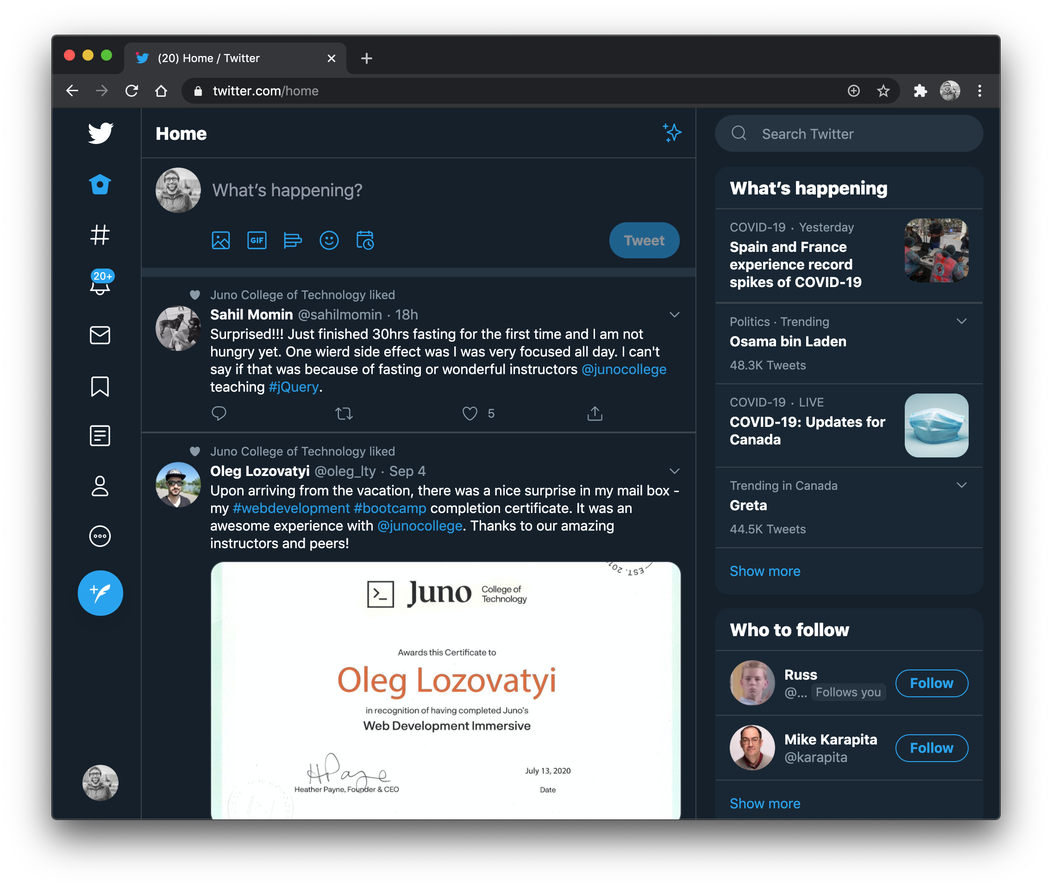
Imagine trying to manage Twitter using HTML!

Slide 23
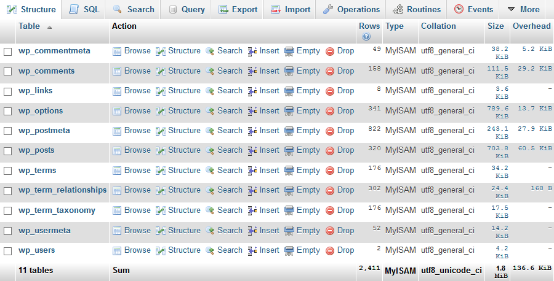

MySQL and SQL
PHP works with SQL and MySQL to integrate a website with content from a database.

Slide 24








Other Useful Things
PHP can be used to:
Create images and videos (FFmpeg, gdLibrary)
Create any type of text file (HTML, CSS, XML, JSON)
Interact with APIs (Facebook, Twitter, Open Weather Map)
Initiate financial transactions (Stripe, PayPal, Moneris)
And more!

Slide 25








Class Requirements
To code PHP will need:
An IDE (Integrated Development Environment) (Visual Studio Code, Sublime, Notepad++) I will be using Visual Studio Code during online classes and videos
An FTP program (FileZilla, Cyberduck)
A hosting account (GoDaddy, HostPapa, Media Temple, Infinity Free)
Optional: A local PHP server (WAMP, MAMP)

Slide 26
Let’s Code a
Sample PHP file

Slide 27
5. Goals this Week
1. Understand the role of PHP 2. Upload and view a PHP file on your server

